Slide 1
A Context-Aware Approach to Android Memory Management
by
Srinivas Muthu

Slide 2
Before we get started..

Slide 3
Introduction

Slide 4
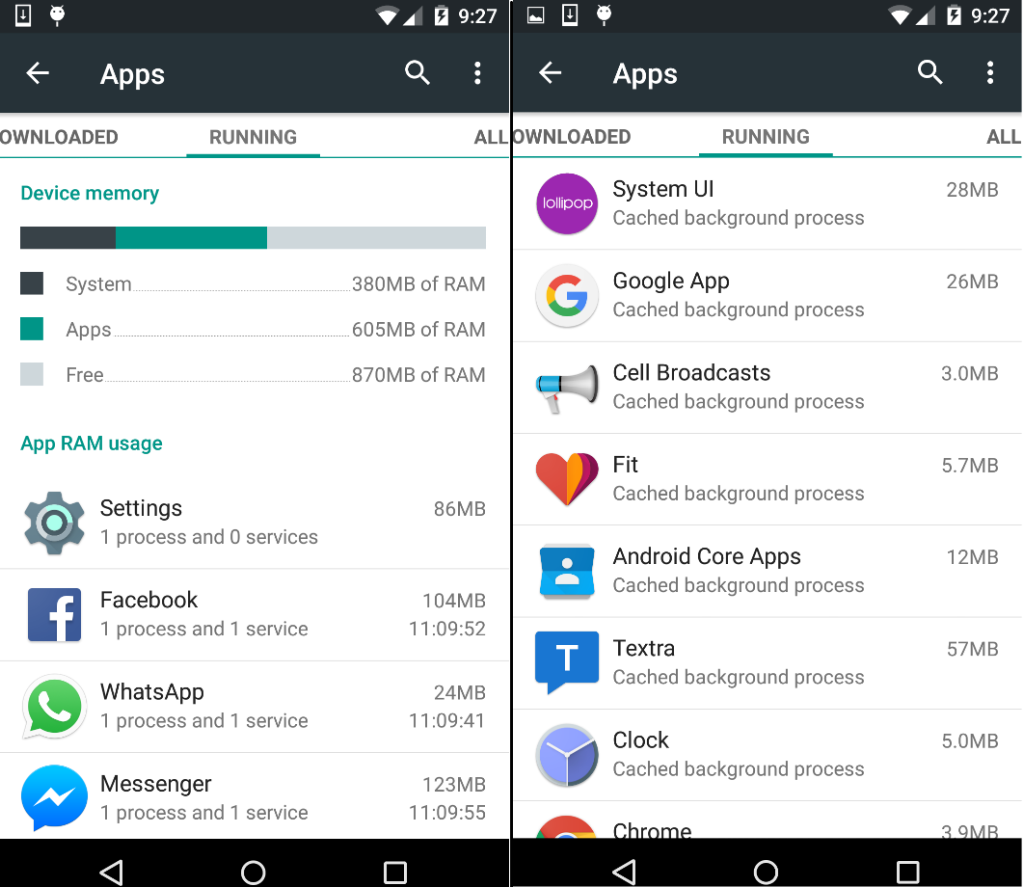
The Problem
Android built on top of Linux kernel
Every app runs in its own Linux process.
RAM contains active processes & CBP(s)
Displayed by Settings App
Lower startup time => Better UX
Determined by Recency of Usage
Better scheme?
Can context help?

Slide 5
Proposed Solution
Utilize context through Calendar
Predict apps likely to be used
3 possible caching schemes
Default (Recency)
Context (Calendar)
Default-Context Hybrid
Set up experiment (20 volunteers)
Compare efficiencies
Metrics?
How to get them?
Did context help?
Assumptions
Context through Calendar
Easy access (Android provides Public API)
Window into user’s potential future behavior
Android version in volunteer’s phone
API Level 21 (Lollipop 5.0) & above
Volunteers permit use of their calendar

Slide 6
Related Work

Slide 7
Early Studies in Context-Aware Computing
Dey, Salber & Abowd (2001)
A conceptual framework and a toolkit for supporting the rapid prototyping of context-aware applications
Defined Context
Humans, apps and surrounding environment
Inadequate research in Context Aware Applications
Context – Ill defined
Lack of conceptual models to jumpstart context-aware apps (back in ‘01)
Produced Context Toolkit
Framework to infer context from sensors
Modern day APMD(s) are perfect fit
Sensors measure 3D movement, positioning etc.
Suitable for utilizing context information

Slide 8
Context Phone
Mika Raento, Antti Oulasvirta, Renaud Petit, and Hannu Toivonen (2005)
ContextPhone: A Prototyping Platform for Context-Aware Mobile Applications
Mobile phones are suited for Context-Aware computing
Intimate user-phone relationship
Developed ContextPhone to provide context as a resource
4 components : Sensors, Communication Services, Customizable Applications and System Services
Necessity for customizable applications lead to Android
Android is open sourced (AOSP) => Highly customizable
Facilitates gathering relevant metrics
Not possible in iOS or other OS(s)

Slide 9
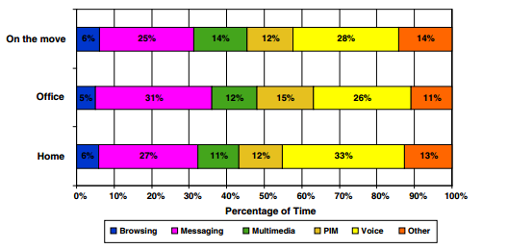
Context Patterns in Application Usage
Hannu Verkasalo (2007)
Contextual Patterns in Mobile Service Usage
Context influence service?
Context – Home, Office & On the move
Tracked user’s location patterns
Determined Context
Found Location : Service correlation
Preference for certain services in the weekends
Planted idea for inferring app usage from Context

Slide 10
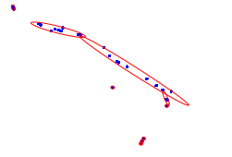
Alternate Ways to Utilize Context
Elaine Shi, Yuan Niu, Markus Jakobsson, and Richard Chow (2010)
Implicit Authentication through Learning User Behavior
Modelling user behavior
Calls/Day, Location traces
Implicit authentication
Good score vs bad score
High bad score => lock phone
Context :- utilized in various ways

Slide 11
Metrics of Interest

Slide 12

Cache Hits, Cache Misses & CHR
Cache Hit
User requests app already in memory
Either as active process or CBP
E.g. Messenger
Cache Miss
User requests app not in memory
Neither as active process nor CBP
E.g. Google Drive
Cache Hit Ratio
Ratio of hits to overall requests
CHR = (Hits / Hits + Misses)
Higher CHR => Lower startup time for more requests => Better UX

Slide 13
Caching Schemes Under Consideration

Slide 14
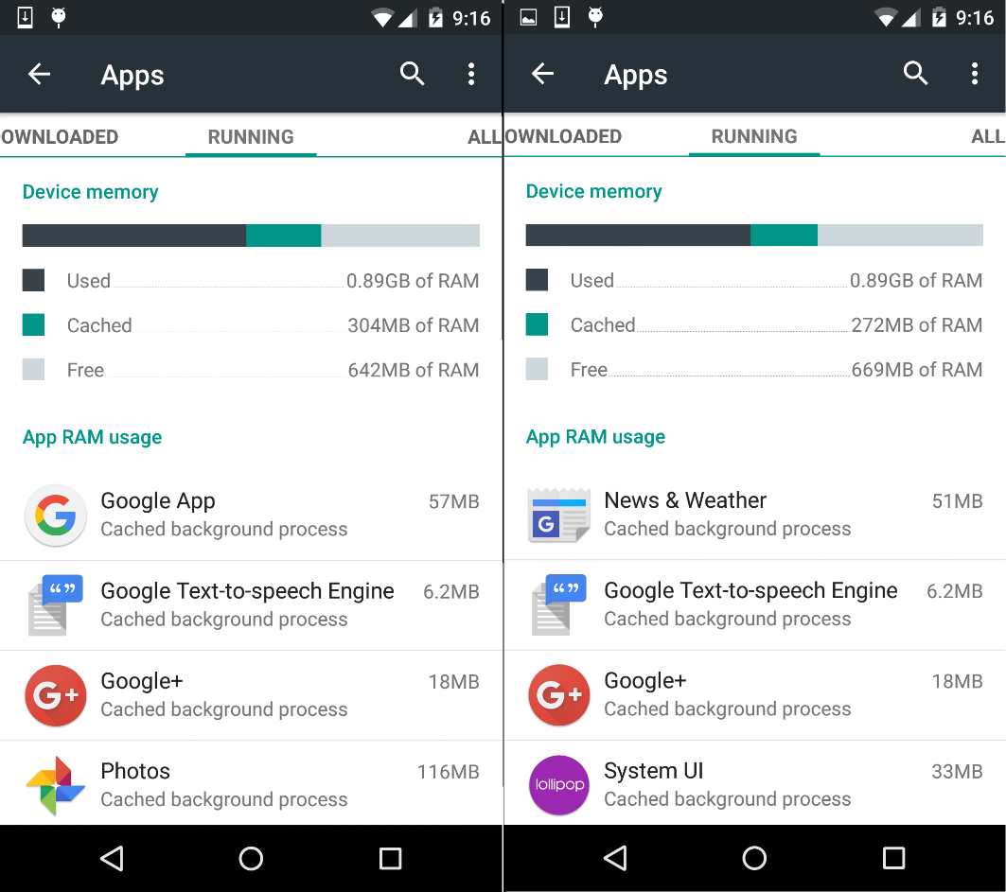
Default – Recency of Usage
Recency of application usage
CBP(s) have timestamps
Memory low => LRU CBP removed
Requesting an app not in memory
Cached as CBP after use
E.g. News & Weather app

Slide 15
Alternatives
Optimal
Always have requested app
Not Implementable in practice
Impossible to predict exact user behavior
Random
Randomly cache an app as CBP
Simplicity
No time-stamps or any meta info required
Used in ARM processors
No benefit in caching apps randomly
Frequency of Usage
MFU apps cached as CBP(s)
Potentially great fit
Smartphone user tendencies => Few apps with high frequency => Always cached in RAM
Our focus is Context Analysis
Revisit in future scope

Slide 16
Default-Context Hybrid
Previous schemes based on past behavior
Hybrid = Default + Context
Default : Recency of Usage
Context : Read Calendar -> Parse events -> Predict apps likely to be used
Combined list used for computing metrics
For Hybrid to work
Provision for Android to pro-actively cache apps
Prioritizing apps when memory is low

Slide 17
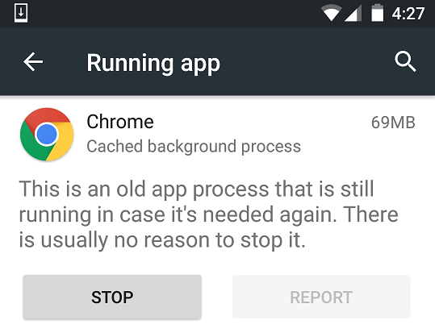
Pro-actively Caching Applications
Needed why?
What to do with list of apps predicted from context?
Provision for Android to pro-actively cache these as CBP(s)
Provision exists
Demonstrated through small experiment
Settings App -> Delete each CBP -> Idle phone for 3 minutes -> Settings App -> CBP list non-empty
Some from previous list, some brand new
Not just provision, it already does so

Slide 18
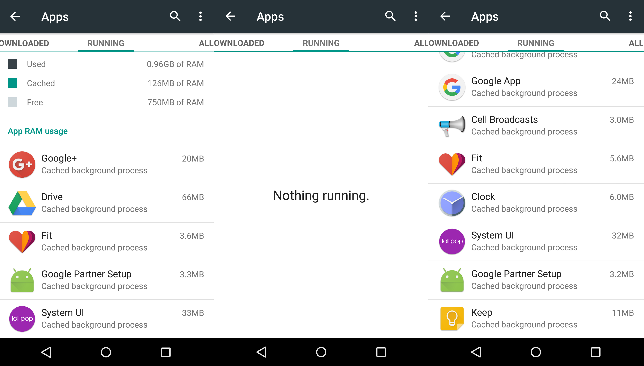

Slide 19
Prioritizing Applications in Hybrid Scheme
Hybrid scheme
Apps from default scheme (based on recency) → List 1
Apps inferred from Context (predicted from calendar) → List 2
Memory Low => Who has priority?
Recency cannot apply for overall list
Three Options
List 2 Priority > List 1 Priority
Context Inference implemented well
List 1 Priority > List 2 Priority
Context inference still in infancy
Memory heavy removed first
Releases memory quickly
Does not factor likelihood of usage

Slide 20
Supplementary Data
Fundamental metric → CHR
Measured for Default, Context & Default-Context Hybrid
Supplementary data → Check for correlations
#Installed Apps
#Unique Apps Clicked
#Calendar Entries
Gender, Age, Phone Model
Clues about usage patterns
Diversity in demographic
Android OS Version
For compatibility with experiment

Slide 21
Challenges in Collecting the Metrics

Slide 22
System vs User Level Approach
System Level Approach
Altering source code of Android OS (AOSP)
Building custom distribution to gather cache metrics
User Level Approach
Developing Android App to gather relevant data
Easier approach
Altering Android OS → Higher complexity
Easier for research volunteers
Is it solvable at the user level?
Getting list of processes in memory ✓
Obtaining current foreground application ✓
Reading the user’s calendar ✓

Slide 23
Getting Processes in Memory
Needed Why?
Need CHR for comparing efficiencies of the 3 schemes
Need this list for computing hit, miss & CHR
Pre 5.0 solution
getRunningTasks() & getRunningAppProcesses()
ActivityManager’s helper methods
Deprecated & only returns requesting app respectively
UsageStatsManager
Requires special permission from user in Settings App
Some OEM(s) removed setting explicitly
Unreliable solution

Slide 24
Getting Processes in Memory (Contd.)
Using Android Debug Bridge Shell
ADB → Command line tool for communication with APMD
Client-Server program
ADB provides Unix shell → Commands on APMD
Toolbox command
Encapsulates many Linux commands into 1 binary
Needed in getting list of processes in memory
Libraries Used
libsuperuser
Framework to run shell commands
AndroidProcess
Framework to parse process related shell output
Algorithm to retrieve processes in memory
Refer to Pseudo Code

Slide 25
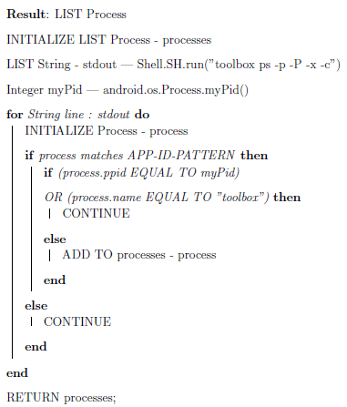
Getting Processes in Memory (Contd.)
Shell.SH.run → libsuperuser
Process → AndroidProcess
Custom data structure for parsing shell output
APP-ID-PATTERN → Regex maps to app ID patterns for 5.0+
myPid → Requesting app
toolbox related processes are removed

Slide 26
Obtaining Current Foreground Application
Needed Why?
Need to update hits & misses
Hits & misses occur during new app launches
Need ability to get current app viewed by user
Problem → Obtain foreground app
System Level solution → Screen touch
Obtain foreground process though elimination
Utilize unique properties in attributes like pid, uid etc.
Algorithm to obtain foreground app
Refer Pseudo Code

Slide 27
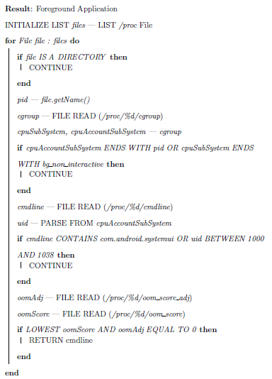

Slide 28
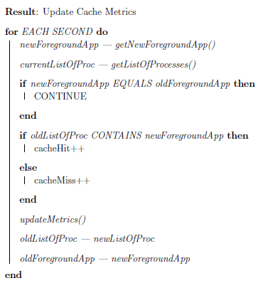
Updating the Statistics
Get list of processes in memory ☑ → Algorithm 1
Get foreground application ☑ → Algorithm 2
Every new app request → Need to update stats, how?
Rate of APMD usage varies
Hard to predict when user changes app
Solution
Start background service and run Algorithm 1 & 2 every second.
If change in foreground app detected → Update Cache Metrics
Refer to Pseudo Code

Slide 29
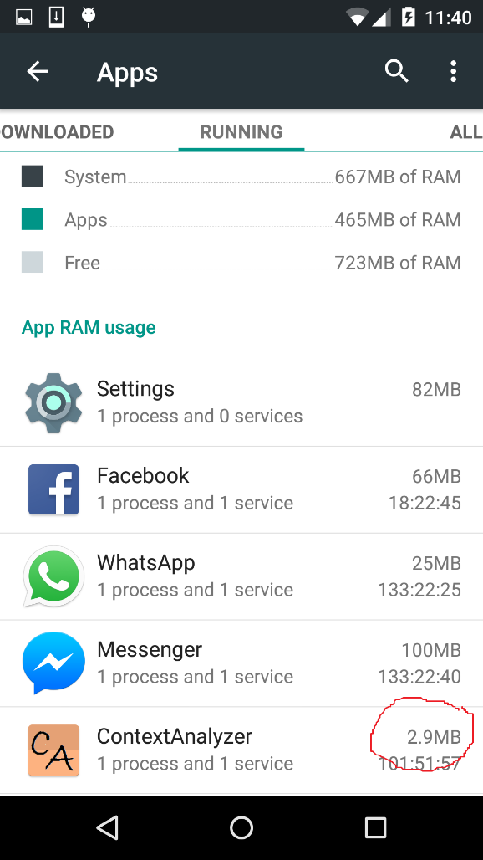
Backing Up the Data
Needed Why?
Background service runs throughout experiment
Results in ⬆ in OOM score => Potential for data loss
OOM score based on combination of duration & memory released
Our app → High duration, low memory footprint

Slide 30
Backing Up the Data (Contd.)
How to store the data?
Android provides 5 ways
Shared Preferences
Primitive data → Key, Value
Internal Storage
Private Data → Device Memory
External Storage
Public Data -> Shared External Storage
SQLite Database
Structured Data -> Relational DB
Network Connection
Any Data → Internet

Slide 31
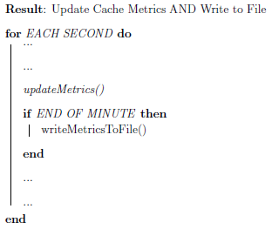
Backing Up the Data (Contd.)
Internal Storage is best fit
Keeps cache data private to app
Cache data is primitive
SQLite & Network connections → Overkill
Algorithm
Data written to file every minute
Worst case → 59 seconds of data lost
Tradeoff between constant I/O operations and data backup
Add to Update-Stats algorithm
App relaunch → Stats loaded from file

Slide 32
Reading the User’s Calendar
Needed Why?
To compute CHR of Hybrid scheme
List of events from user’s calendar
Parsing the events to produce list of predicted apps
Solution
Google provides public API to user’s calendar
Query calendar for events
Every 4 hours → For events in the upcoming 4 hours
Feed list of events → To module that parses calendar events
Get list of predicted apps
Algorithm
Get list of events from user’s calendar
Modify Update-Stats algorithm to update list of predicted apps

Slide 33
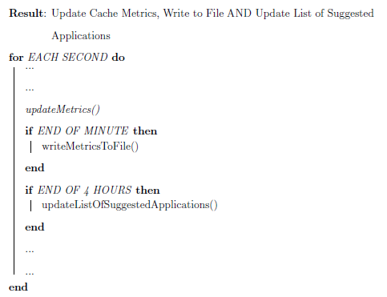
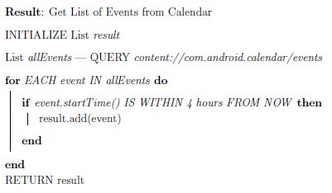
Reading the User’s Calendar (Contd.)
Get List of Events from Calendar
Update List of Predicted Apps

Slide 34
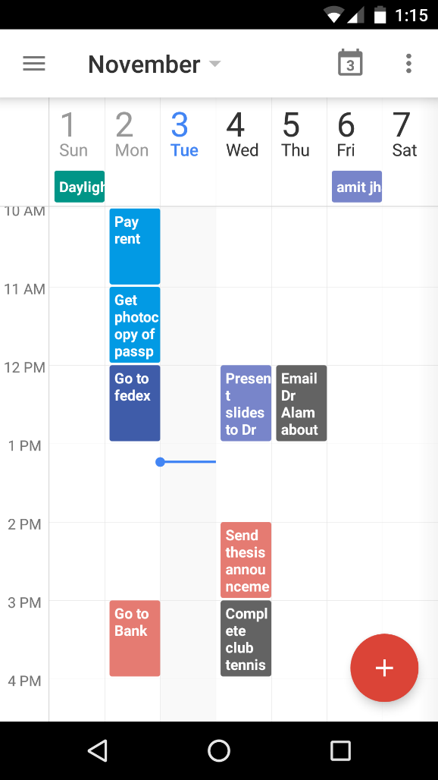
Parsing the Calendar Information
Reading User’s Calendar ✓
How to parse this information?
Solution
Each event → split into keywords
Keyword → App(s) predetermined mapping
How is mapping determined?
Default app directly maps to keyword
Mail → Gmail (Default e-mail application)
Call → Google Dialer (Default Calling application)
Search Google Play Store with keyword
Top Result is mapped to keyword
If present in list of installed apps
Skype keyword → Search result was Skype app
No events in 4 hour period
Default list from top 10 Android apps in US
Maximum 10 chosen

Slide 35
The Experiment

Slide 36
Eligibility for Volunteers
ContextAnalyzer → Android app to collect cache metrics
Criteria for eligibility
Own APMD with 5.0+
Previous algorithms won’t work
E.g. APP-ID-PATTERN
Willing to install 3rd party app
Permission to read calendar
Addressing Privacy Concerns
3rd party app → Privacy concerns
Full Transparency
Explained nature of data collected
Open sourced ContextAnalyzer
No centralized server, volunteers sent all data

Slide 37
Process & Duration of the Experiment
20 volunteers
7 days ≤ Duration ≤ 12 days
Account for weekends
ContextAnalyzer APK → Posted online → Downloaded as 3rd party app
App not downloaded from Google Play Store => 3rd party app
Instructed not to forcefully stop app
End of monitoring period → Sent Data

Slide 38
Application Design

Slide 39
Classifying Each Application Request
Hybrid CHR
(A + B + C) / (A + B + C + D)
Default CHR
(A + C) / (A + B + C + D)
Context CHR
(A + B) / (A + B + C + D)
Suggested Hits & Default Hits → A | Suggested Hits & Default Misses → B
Suggested Misses & Default Hits → C | Suggested Misses & Default Misses → D

Slide 40
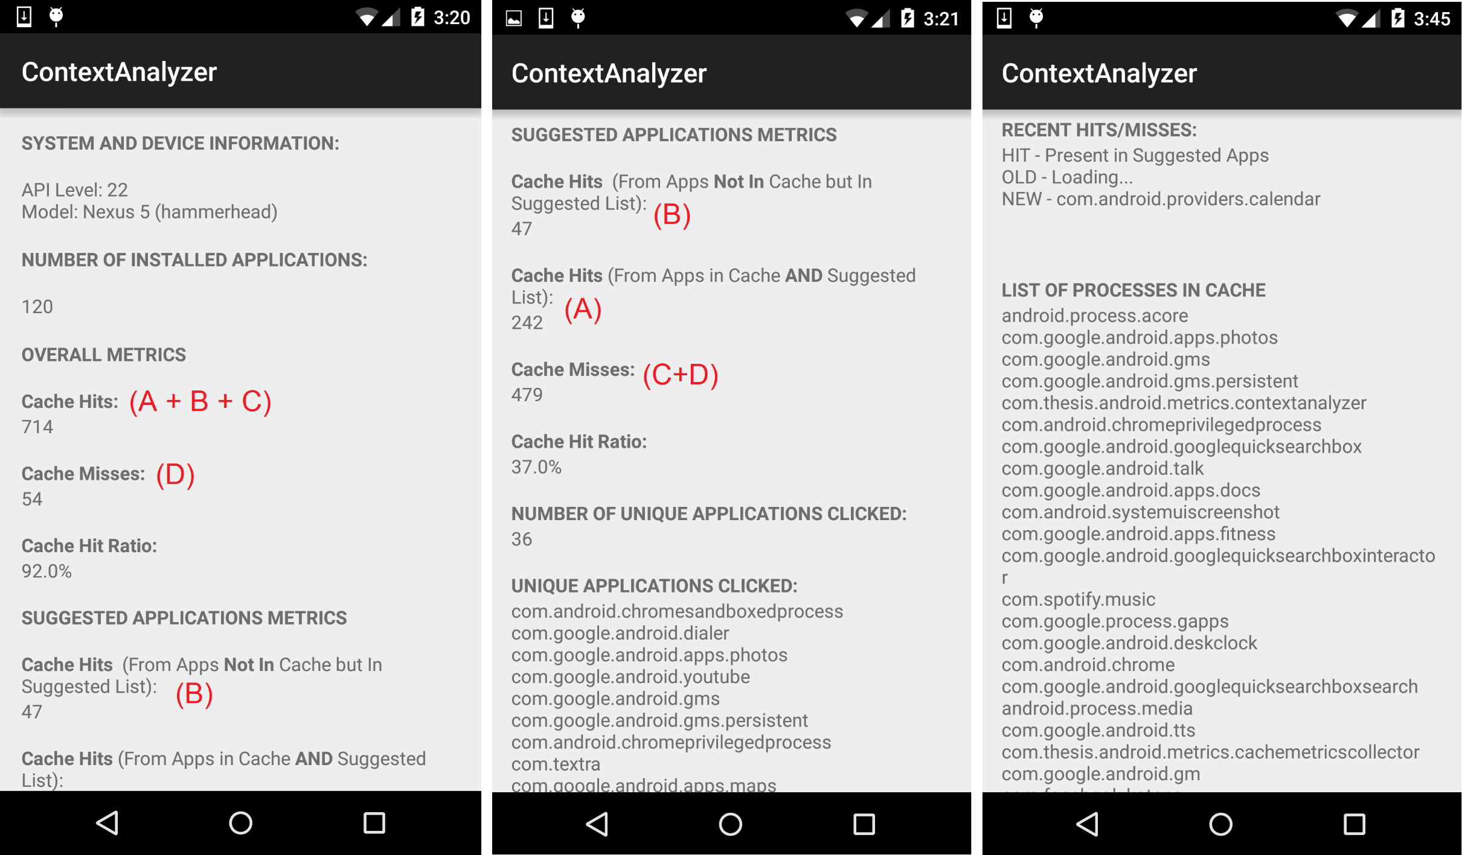

Slide 41
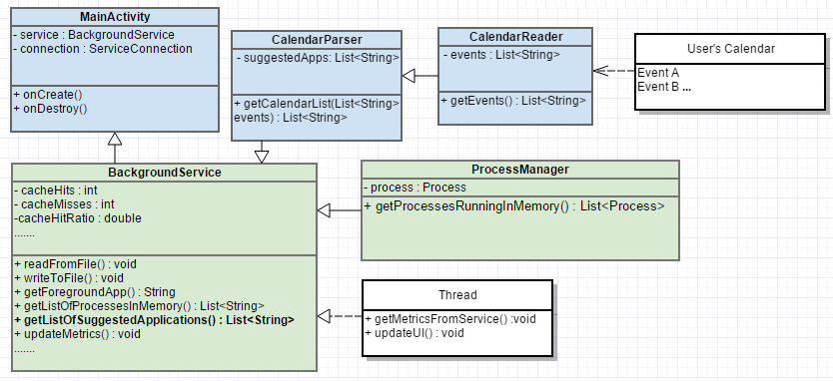

Slide 42
Data Analysis & Results

Slide 43
Demographic Data Distribution
Demographic Data
Age, Gender
Phone Model, OS Version
Supplementary Data
# Calendar Entries
During experiment
(11, 25, 43)
# Unique Apps Clicked
During experiment
(34, 46, 56)
# Total Installed Apps
At start of experiment
(120, 295, 374)

Slide 44
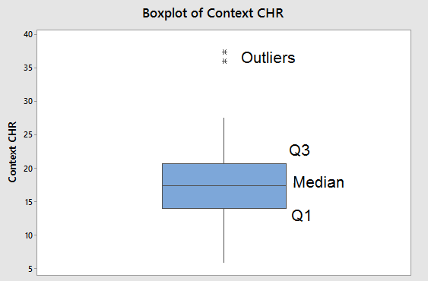
Context Scheme Results
Max CHR 37.39%
Average CHR 18.47%
Roughly 4 in 5 miss
SD 7.67%
Variance 58.75
Minimum CHR 5.92%
Roughly 1 in 16 hit
(Q1, Median, Q3) → (14.05%, 17.35%, 20.68%)

Slide 45
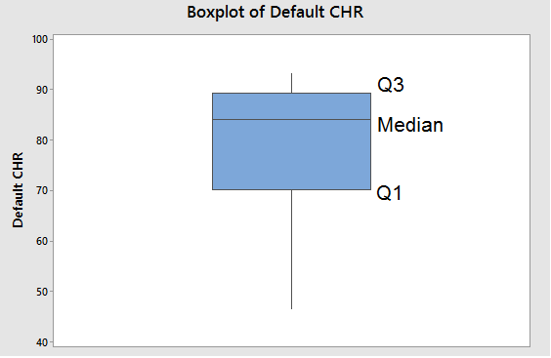
Default Scheme Results
Max CHR 93.19%
Average CHR 79.17%
Roughly 4 in 5 hit
SD 13.87%
Variance 192.37
Minimum CHR 46.52%
Less than 1 in 2 hit
(Q1, Median, Q3) → (70.28%, 84.04%, 89.34%)

Slide 46
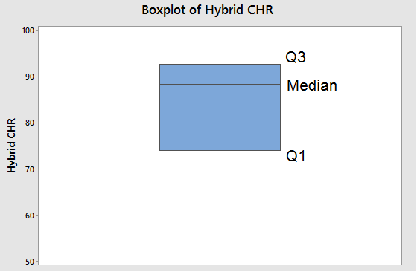
Hybrid Scheme Results
Max CHR 95.62%
Average CHR 83.50%
More than 4 in 5 hits
SD 12.39%
Variance 153.49
Minimum CHR 53.48%
Less than 1 in 2 miss
(Q1, Median, Q3) → (73.97%, 88.48%, 92.73%)

Slide 47
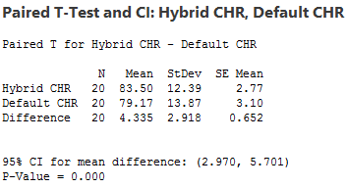
Significance Testing
Observed effect could be sampling error
⬆ in CHR significant? → Paired T Test
Null Hypothesis & Significance Level
0.05 by convention
P-value
The lower the better!
Strong evidence to reject Null Hypothesis
95% CI between 2.97% & 5.701%
Bounds for true average ⬆ in CHR

Slide 48
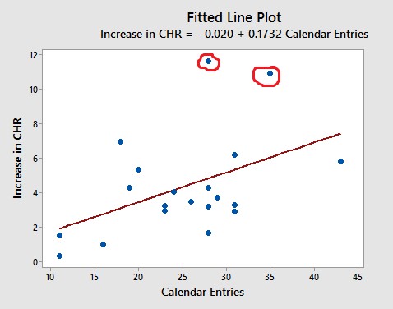
Increase in CHR vs #Calendar Entries
Compute PPMCC
PPMCC = 0.467
Modest positive correlation
P-value = 0.038
For significance level = 0.05
Statistically significant
Linear Plot with +ve slope

Slide 49
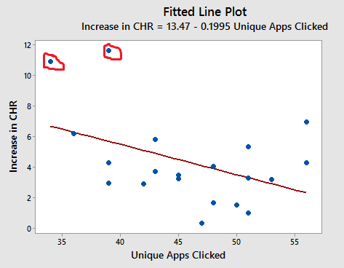
Increase in CHR vs #Unique Apps
Compute PPMCC
PPMCC = -0.437
Modest negative correlation
P-value = 0.054
For significance level = 0.05
Approximately equal to SL
Statistically significant
Within margin of error
Linear Plot with –ve slope

Slide 50
Points of Weakness

Slide 51
Points of Weakness (Contd.)
Sample Size
May/ May not use calendar
Changes with known incentive
Calendar entries not indicative of app
Not all apps have keyword mapping
Synced only once every 4 hours
Can be changed
2 app requests within 1 second
Personally unable to achieve it
Lack of diversity in volunteer demographic
Full Transparency => Chance for bias
No inherent motive
Possible to selectively close app
No inherent motive

Slide 52
Conclusion & Future Work

Slide 53
Conclusion
Smartphones good fit for context
Android caches app components for quicker startup
Currently through Recency of Usage
Scope for Context Inference
Set up Experiment
20 volunteers
Android app to read calendar & measure metrics for 3 schemes
Default, Context & Default-Context Hybrid
Analyzed Data
On average, Hybrid significantly > CHR than Default.
Lower startup time for more apps => Better UX
Bigger Picture (This is just proof of concept)

Slide 54
Future Work
Other sources of info to get Context
APMD sensors
3D Movement, Positioning & Environmental conditions
Multiple sources => Reliability of Context Information ⬆
User Behavior Model → Shi et al.
Used to predict apps
Predetermined Mapping
Improved by learning user’s preferences
App always used in conjunction with Event
Learn Behavior & Modify mapping
Implement the Hybrid Scheme by modifying Android OS
Facilitated by AOSP

